Slide 1

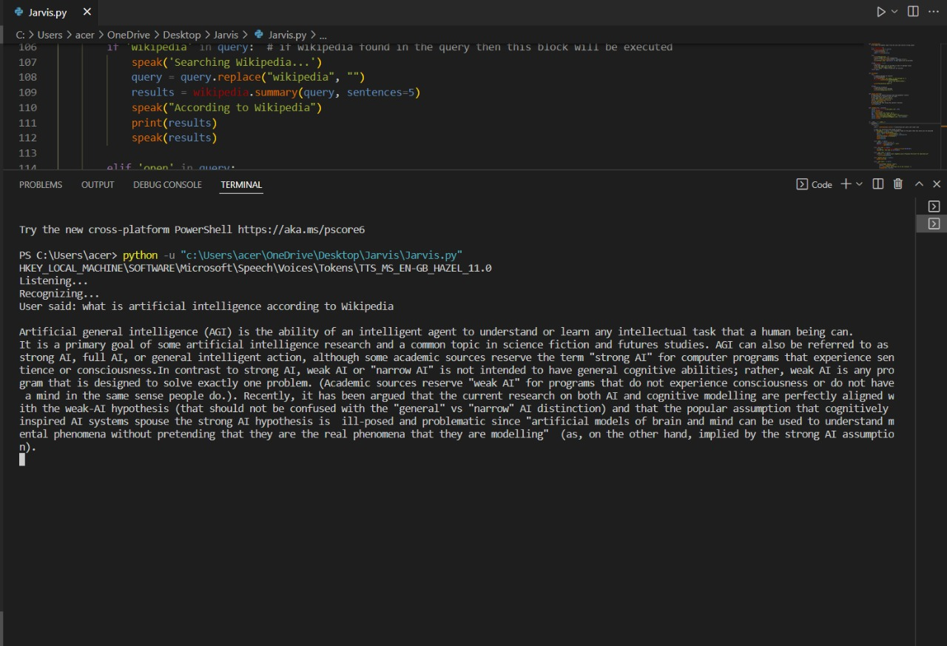

Nebula-Your Voice Assistant
By :- Aarav Gupta , RollNo :- 102053039
Kanan Singla ,RollNo :- 102003504

Slide 2
INTRODUCTION
Intro
Purpose
Objectives
Applicability
Hardware & Software Used

Slide 3
Intro
In today’s era, almost all tasks are digitized. We have Smartphone in hands and it is nothing less than having world at your fingertips. These days we aren’t even using fingers. We just speak of the task and it is done. There exist systems where we can say Text Dad, “I’ll be late today.” And the text is sent. That is the task of a Virtual Assistant.
Virtual Assistants are software programs that help you ease your day to day tasks, such as showing weather report, creating reminders, making shopping lists etc. They can take commands via text (online chat bots) or by voice.

Slide 4
Purpose
The purpose of a virtual assistant is to be capable of voice interaction, music playback, making to-do lists, setting alarms, streaming podcasts, playing audiobooks, and providing weather, traffic, sports, and other real-time information, such as news. Virtual assistants enable users to speak natural language voice commands in order to operate the device and its apps.

Slide 5
Objectives
Main objective of building personal assistant software (a virtual assistant) is using semantic data sources available on the web, user generated content and providing knowledge from knowledge databases.
The main purpose of an intelligent virtual assistant is to answer questions that users may have. This may be done in a business environment, for example, on the business website, with a chat interface. On the mobile platform, the intelligent virtual assistant is available as a call-button operated service where a voice asks the user “What can I do for you?” and then responds to verbal input.

Slide 6
Applicability
The mass adoption of artificial intelligence in users’ everyday lives is also fueling the shift towards voice. The number of IoT devices such as smart thermostats and speakers are giving voice assistants more utility in a connected user’s life. Smart speakers are the number one way we are seeing voice being used. Many industry experts even predict that nearly every application will integrate voice technology in some way in the next 5 years. The use of virtual assistants can also enhance the system of IoT. Twenty years from now, Microsoft and its competitors will be offering personal digital assistants that will offer the services of a full-time employee usually reserved for the rich & famous.

Slide 7
Hardware & Software Used
HARDWARE:
Pentium-pro processor or later.
RAM 512MB or more
SOFTWARE:
Windows 7(32-bit) or above.
Python 2.7 or later
Chrome Driver

Slide 8
What can this A.I. assistant do for you?
It can send emails on your behalf.
It can play music for you.
It can do Wikipedia searches for you.
It is capable of opening websites like Google, Youtube, etc., in a web browser.
It is capable of opening your code editor or IDE with a single voice command.

Slide 9
Defining Functions
Speak Function
The first and foremost thing for an A.I. assistant is that it should be able to speak. To make our assistant talk, we will make a function called speak(). This function will take audio as an argument, and then it will pronounce it.
def speak(audio):
pass #For now, we will write the conditions later.
Wish me Function
we will make a wishme() function that will wish or greet the user according to the time of computer or pc.
def wishme():
hour = int(datetime.datetime.now().hour)

Slide 10
Defining Functions
Take command Function
The next most important thing for our A.I. assistant is that it should take command with the help of the microphone of the user's system. So, now we will make a takeCommand() function. With the help of the takeCommand() function, our A.I. assistant will return a string output by taking microphone input from the user.
Send email function
It helps us send emails to one or more than one recipient.

Slide 11
Import/install the necessary libraries :
· pyttsx3
A python library that will help us to convert text to speech. In short, it is a text-to-speech library.
It works offline, and it is compatible with Python 2 as well as Python 3.
import pyttsx3
engine = pyttsx3.init('sapi5')

Slide 12
Import/install the necessary libraries :
voices= engine.getProperty('voices') #getting details of current voice
engine.setProperty('voice', voice[0].id)
What is sapi5?
Microsoft developed speech API.
Helps in synthesis and recognition of voice.
What Is VoiceId?
Voice id helps us to select different voices.
voice[0].id = Male voice
voice[1].id = Female voice

Slide 13
Import/install the necessary libraries :
DATETIME
To provide current or live time to A.I.
import datetime
speechRecognition
pip install speechRecognition
After successfully installing this module, import this module into the program by writing an import statement.
import speechRecognition as sr
WIKIPEDIA
To do Wikipedia searches, we need to install and import the Wikipedia module into our program.
pip install wikipedia
WEBBROWSER
It is an in-built module, and we do not need to install it with a pip statement

Slide 14
Defining Tasks
Task 1: To search something on Wikipedia
if __name__ == "__main__":
wishMe()
while True:
# if 1:
query = takeCommand().lower() #Converting user query into lower case
# Logic for executing tasks based on query
if 'wikipedia' in query: #if wikipedia found in the query then this block will be executed
speak('Searching Wikipedia...')
query = query.replace("wikipedia", "")

Slide 15
Defining Tasks
results = wikipedia.summary(query, sentences=2)
speak("According to Wikipedia")
print(results)
speak(results)
Task 2: To open YouTube site in a web-browser
elif 'open youtube' in query:
webbrowser.open("youtube.com")
. Let' suppose the user gives a command as "J.A.R.V.I.S., open youtube." So, open youtube will be in the user's query, and the elif condition will be true.
Task 3: To open Google site in a web-browser
elif 'open google' in query:
webbrowser.open("google.com")

Slide 16
Defining Tasks
Task 5: To know the current time
elif 'the time' in query:
strTime = datetime.datetime.now().strftime("%H:%M:%S")
speak(f"Sir, the time is {strTime}")
Task 6: To open the VS Code Program
elif 'open code' in query:
codePath = "C:\\Users\\Haris\\AppData\\Local\\Programs\\Microsoft VS Code\\Code.exe"
os.startfile(codePath)

Slide 17
Defining Tasks
Task 7: To send Email
def sendEmail(to, content):
server = smtplib.SMTP('smtp.gmail.com', 587)
server.ehlo()
server.starttls()
server.login('youremail@gmail.com', 'your-password')
server.sendmail('youremail@gmail.com', to, content)
server.close()
Note: Do not forget to 'enable the less secure apps' feature in your Gmail account. Otherwise, the sendEmail function will not work properly.

Slide 18
Recapitulate
First of all, we have created a wishme() function that gives the greeting functionality according to our A.I system time.
After wishme() function, we have created a takeCommand() function, which helps our A.I to take command from the user. This function is also responsible for returning the user's query in a string format.
We developed the code logic for opening different websites like google, youtube, and stack overflow.
Developed code logic for opening VS Code or any other application.
At last, we added functionality to send emails.

